Slide 1
Characteristics of the batteries
Fyodor Malchik

Slide 2
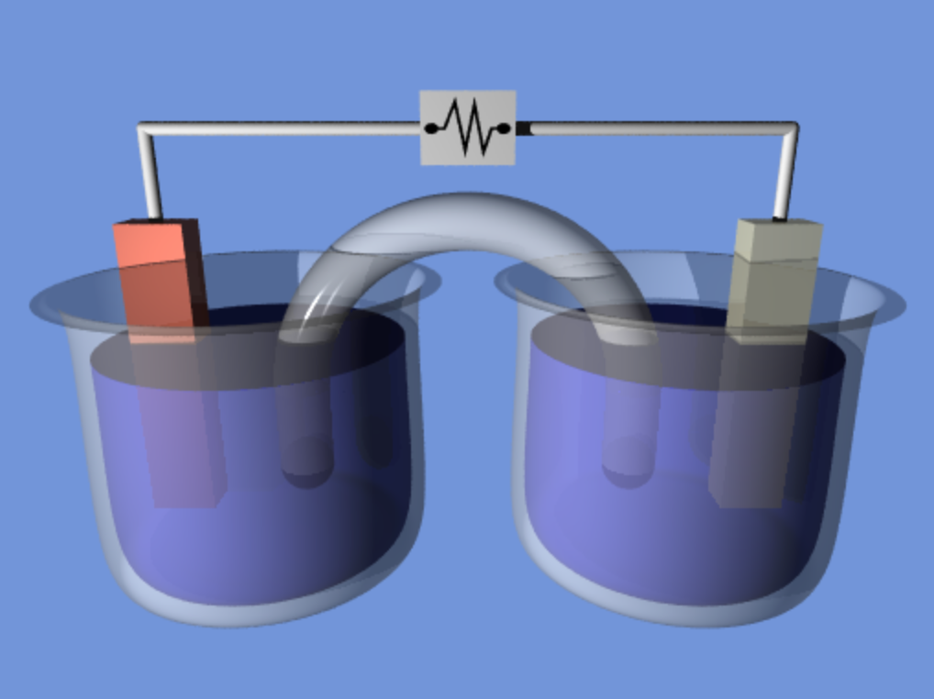
General principle
Anode (-)
M1_{(s)} → M1^{n+}_{(aq)} + ne⁻
Cathode (+)
M2^{n+}_{(aq)} + ne⁻ → M2_{(s)}
When E2>E1 M1(s) + M2^{n+}(aq) → M1^{n+}(aq) + M2(s)
Electromotive force = E2-E1

Slide 3
Exercice
We consider the Daniell cell involving the redox couples:
Cu²⁺/Cu (E° = 0.34 V/SHE) and Zn²⁺/Zn (E° = - 0.76 V/SHE)
Zn ⎜ ZnSO₄ ⎜⎜ CuSO₄ ⎜Cu
1. Establish the half equations and the resulting electrochemical reaction
2. Draw the Daniell cell and specify the polarity of the respective electrodes (justify)
3. Calculate the equilibrium constant of this electrochemical cell
4. Calculate the e.m.f. when [CuSO₄] = 10⁻² M and [ZnSO₄] = 10⁻¹ M

Slide 4
Principle
Convert chemical energy into electrical energy
Based on the reversible electrochemical reaction
A (low energy) = B (high energy)
Charge : A leads to B (non spontaneous)
Discharge : B leads to A (spontanenous)
Batteries are classified into primary and secondary forms.
Primary batteries irreversibly transform chemical energy to electrical energy. When the supply of reactants is exhausted, energy cannot be readily restored to the battery
Secondary batteries can be recharged; that is, they can have their chemical reactions reversed by supplying electrical energy to the cell, approximately restoring their original composition.

Slide 5
To determine the performance of a batterie
The ratio between the energy stored and weight
The ratio between the energy stored and volume
The number of cycles
The self-discharge
The security issue
The ecological impact
The cost

Slide 6
Electrochemical characterization
Cyclic voltammetry (j vs V)
To determine the oxidation/reduction potentials
Chronopotentiometry (V vs t at j=constant)
To establish the charge/discharge profiles (V vs the capacity)
Electrochemical Impedance Spectroscopy
Electron transfer, ionic conductivity, modelling of
interfaces…

Slide 7
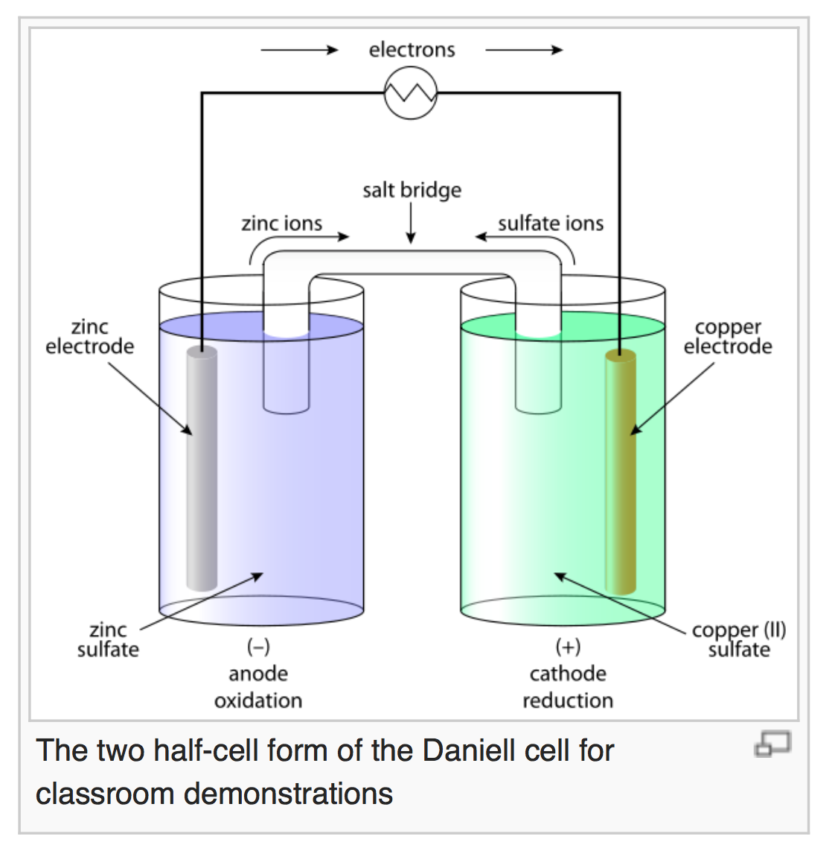
General principle/ Daniell cell
Zn_{(s)} → Zn²⁺_{(aq)} + 2e⁻
Cu²⁺_{(aq)} + 2e⁻ → Cu_{(s)}
Zn(s) + Cu²⁺(aq) → Zn²⁺(aq) + Cu(s)
Open-circuit voltage 1.1 V

Slide 8
Characteristics of batteries
The potential: U (V). In general 1 to few V
It can be increased by assembling cells in series
The current: i (A) or j(A/surface area).
It can be increased by assembling cells in parralel
The capacity (mAh or C)
Gravimetric capacity (mAh/g)
Volumetric capacity (mAh/cm³)
Areal capacity (mAh/cm²) for microbatteries
The energy density (mWh or J)
E= Capacity X Average operating potential
The power density (mW)
E= Capacity X Average operating potential/Discharge time
The internal impedance (Ω)

Slide 9
Li-ion batteries
Principle and Applications

Slide 10

Supercapacitors: High power density and low energy density
Li-ion batteries: Low power density and high energy density

Slide 11
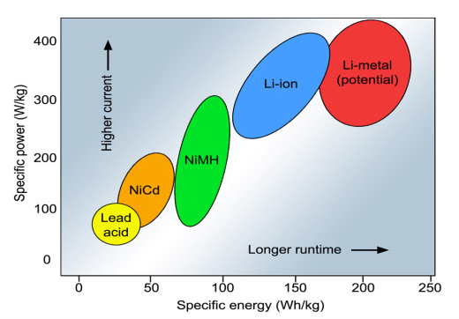

Slide 12
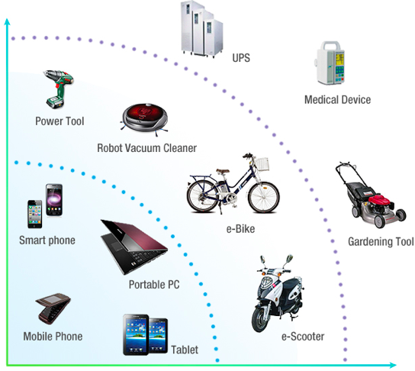

Slide 13
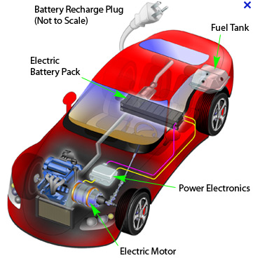
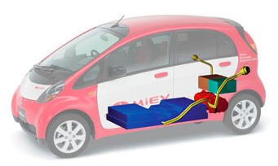
HYBRID
100% ELECTRIC

Slide 14
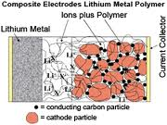
The Li metal technology
1. Anode: Li metal
2. Cathode : Host materials with high potential (Oxyde)
Poor electronic conductivity. Mixed with C black and binders
3. Electrolyte: liquid (LiPF₆ + EC/DEC) or polymer (PEO)
4. Current collectors (Cu or Al)
ECM/CM⁻ > ELi⁺/Li Spontaneous reaction is the discharge
Oxidation: Li = Li⁺ + e⁻
Reduction: Host + e⁻ = Host⁻
The overall reaction:
Host + Li = Li⁺,Host⁻

Slide 15
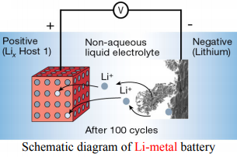
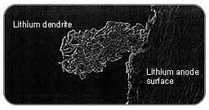
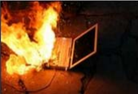
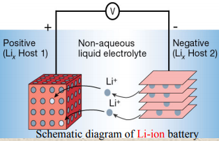
Li batteries vs. Li-ion batteries
Li-metal battery (very high energy density)
- Safety problems (short circuit due to the dendrite formation during charging)
The lithium-ion battery has a slightly lower energy density than lithium metal, but is much safer.

Slide 16
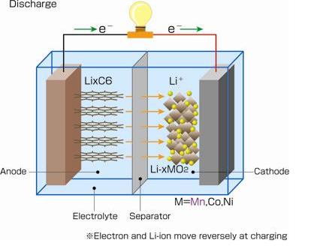
Concept developed by SONY in 1990 using graphite (anode) and LiCoO2 ( cathode)
Oxidation: Li_{x}C₆ = x Li⁺ + xe⁻ + C₆
Reduction: Li_{1-x}MO₂ +xe⁻ + x Li⁺ = LiMO₂
Li_{1-x}MO₂ + Li_{x}C₆ = C₆ + LiMO₂

Slide 17
The electrode reaction mechanisms
The main concern: the volume variation during cycling
Insertion of Li = volume expansion
extraction of Li = volume contraction
Consequence : mechanical strain at the interface electrode/current collector leading to the lost of electrical contact

Slide 18
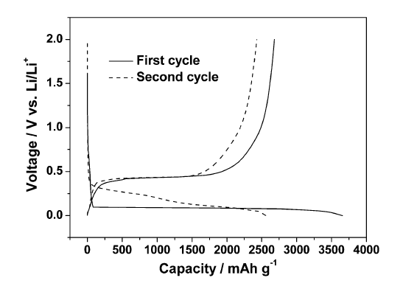
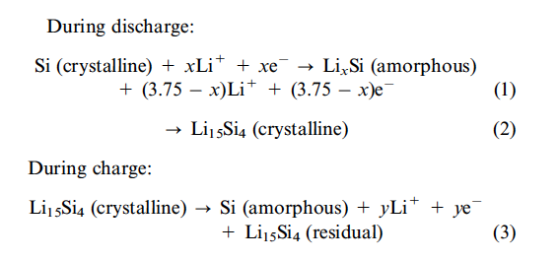
Example of Si: poor electrochemical performance
(number of cycles<3) due to a volume expansion of 400%
The problem of volume variations

Slide 19
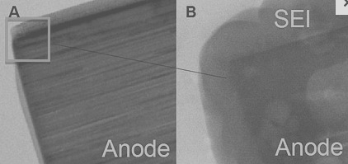
Formation of a solid electrolyte interphase (SEI)

